Slide 1


Bank of Baroda Hackathon - 2022
Technology Partner
Your Team Name : LC You
Your team bio : To Make Aspiring Technologies
Date : 14/09/2022

Slide 2
Problem Statement Case 6 - Alternate Authentication
Description of what our Team has tried to build :
We considered making the login processes and security questions asked on online websites more entertaining and engaging using image selection. We Ask the user to Select the Interface related to the field of interest with some objects available in the interface. The user can set the password in their favorable sequence.

Slide 3

Registration Flowchart
Obtain the username and password along with the data required for the banking information.
Ask the user to Select their area of interest Like Hospital, Study room, lifestyle etc., to the chosen fields with N number of objects in the interface
Click 4 or more objects based on your priority order.
FALSE
Is the selected password has more than 4 objects
TRUE
Register button is disabled
Register button is enabled
Password set successfully

Slide 4
Login Flowchart
Obtain the username from the user
Show the chosen Interface
Click the objects in the same pattern as same as in the registration process.
Is the entered password correct?
FALSE
TRUE
Invalid Password
Login successfull

Slide 5
Tools and framework details HTML and CSS for front end and python django is used for back end. The datas are stored in SQLite3. The algorithms / machine learning models that have been used in the Hackathon prototype Hashing Algorithm is used for the encryption and decrytion of the password for strong security.

Slide 6
A write-up on why our application /solution should be considered. According to research compiled by 3M, the corporation behind Post-it Notes, visuals are processed 60,000 times faster than text, It’s no surprise that HubSpot’s social-media scientist Dan Zarrella found that images are 94% more likely to be remembered by people than text. People find it simpler to recall a visual pattern than a complex overall password. Some senior citizens in our nation struggle to remember complex passwords, so they write them down, keep them, and ask a stranger to help them enter it during the login procedure, making the process insecure. However, majority of elderly people can recall images that are specific to their particular field of interest, therefore we made those images as their password so they wouldn't have to share it with anyone.

Slide 7
Give this as a general login password choice initially, after the public response, our idea can be replaced with the general login procedure. Additionally, there is a different technique known as the interactive approach, which involves bringing things closer to one another in order to create a password that is more secure and more interesting to choose. creating more interfaces may give job oppurtunites. Infrastructure required for setting up the PoC. we have combined everything and done as a single site if the bank needs to use the password method from our site. Just insert this login and register page over their banking site becuase our site will generally create a password as a normal one in backend which can be used in normal process of a banking site. So, any other special infrastructure is not needed.
Ability to scale-up in enterprise grade environment.

Slide 8
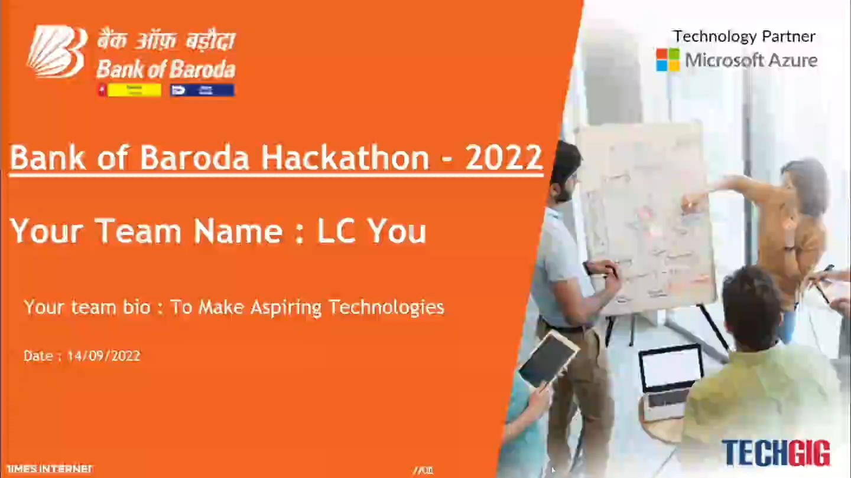

Slide 9
Thank You
Team member :
Lokesh C (Leader)
Murugappan PR
Hari Krishnan C M
Maaneesha S

